Slide 1
Data Ingestion
Pravin Y Pawar

Slide 2
Data Ingestion
Process of moving data from a source into a landing area or an object store where it can be used for ad hoc queries and analytics.
A simple data ingestion pipeline consumes data from a point of origin, cleans it up a bit, then writes it to a destination
Importance
Helps teams go fast!
Scope of any given data pipeline is deliberately narrow, giving data teams flexibility and agility at scale
Once parameters are set, data analysts and data scientists can easily build a single data pipeline to move data to their system of choice
Common examples of data ingestion include:
Move data from Salesforce.com to a data warehouse then analyze with Tableau
Capture data from a Twitter feed for real-time sentiment analysis
Acquire data for training machine learning models and experimentation
Modern Data Integration Begins with Data Ingestion
Data engineers use data ingestion pipelines to better handle the scale and complexity of business demands for data
Lots of intent-driven data pipelines operating continuously across the organization without direct involvement of a development team
Data ingestion has become a key component of self-service platforms for analysts and data scientists to access data for real-time
analytics, machine learning and AI workloads.

Slide 3
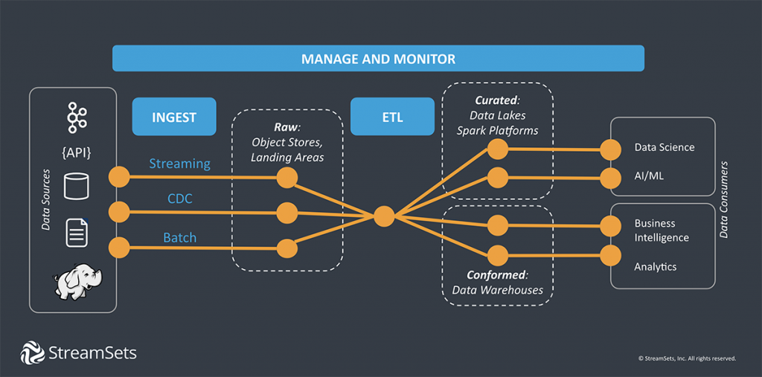
Working

Slide 4
Working(2)
Data ingestion extracts data from the source where it was created or originally stored
Then loads data into a destination or staging area
A simple data ingestion pipeline
might apply one or more light transformations
enriching or filtering data
before writing it to some set of destinations, a data store or a message queue
More complex transformations
such as joins, aggregates, and sorts
for specific analytics, applications and reporting systems
can be done with additional pipelines

Slide 5
Components
Data Sources
Data teams have moved way beyond the walled garden of the enterprise data center for insight
increasingly load data from across business units as well as 3rd party and unstructured data, start data loads, when and where they need it
Common data source types:
Apache Kafka
JDBC
Oracle CDC
HTTP Clients
HDFS
Data Destinations
A data ingestion pipeline may simply send data to an application or messaging system, or store ingested data in a data lake or cloud object storage for use in relational and
NoSQL databases or data warehouses
Common destination:
Apache Kafka
JDBC
Snowflake
Amazon S3
Databricks
Cloud Data Migration
Enterprise business processes are moving to cloud-based platforms for storing, processing and applications
Data ingestion workloads have become essential to cloud migration
But moving data out of silos and into agile cloud data lakes or powerful cloud data warehouses, generates some uncomfortable questions
The more data platforms can automate and operationalize the what-ifs of data ingestion, the better they can support the growing demand for continuous, reliable data.

Slide 6
Data Ingestion vs Data Integration
Data ingestion originated as a small part of data integration, a more complex process required to
make data consumable in new systems before loading it
Data integration usually requires advance specification from source to schema to transformation to destination
With data ingestion, a few light transformations may be made, such as masking personally identifiable
information (PII)
but most of the work depends on the end use and happens after landing the data
Think of it this way:
Data integration includes processes to prepare data to be consumable at its final destination
Data ingestion gets data to places where preparation happens in response to downstream needs
Data ingestion works well for streaming data that can be used immediately with very few transformations or as a
way to collect data for ad hoc analysis
By focusing on the ingestion part of the data lifecycle, companies have been able to speed up the availability of data for
innovation and growth

Slide 7
Data Ingestion Challenges
With the rise of big data, cloud computing, and the demand for real-time analytics, the capacity for data
increased dramatically
old ETL processes began to slow data teams down compared to the ELT model
Complexity Takes Time
The to-do list for data engineering is long and getting longer
Building data pipelines from scratch every time a new source or business need comes up slows down the whole data team
Change Takes Time
Every change or evolution of a target system generates 10-20 hours of work for a data engineer
90% of time will be spent on maintenance and break-fix, changes that are considered data drift
Maintenance and Rework Takes Time
Doing the same thing over and over with a lot of troubleshooting and debugging doesn’t leave much time for innovation or
ramping up on new technologies

Slide 8
Types of Data Ingestion Tools
Hand Coding
One way to ingest data may be to hand code a data pipeline, assuming know how to code and are familiar with the languages needed
gives the greatest control
may spend a lot of time working and reworking code
Single-purpose Tools
Basic data ingestion tools provide a drag-and-drop interface with lots of pre-built connectors and transformation
a quick way to get a lot done or to enable less skilled data consumers,
management of many drag-and-drop data pipelines will be cumbersome
can’t share work with team or the analysts and data scientists knocking on door
Data Integration Platforms
Traditional data integration platforms incorporate features for every step of the data value chain
means most likely need developers and architectures specific to each domain
making it difficult to move fast and adapt easily to change
A DataOps Approach
Applying agile methodologies to data, a DataOps approach to data pipelines automates as much as possible and abstracts away the
“how” of implementation
Data engineers can focus on the “what” of the data, and responding to business needs

Slide 9
Key Engineering Considerations for the Ingestion Phase
Primary considerations related to data ingestion
What’s the use case for the data is ingesting?
Can this data be reused and avoid ingesting multiple versions of the same dataset?
Where is the data going? What’s the destination?
How often should the data be updated from the source?
What is the expected data volume?
What format is the data in? Can downstream storage and transformation accept this format?
Is the source data in good shape for immediate downstream use? Is the data of good quality?
What post-processing is required to serve it? What are data-quality risks?
Does the data require in-flight processing for downstream ingestion if the data is from a streaming source?

Slide 10
Thank You!
Reference
Data Ingestion: Tools, Types, and Key Concepts
How to get data from where it starts to where it can make a difference
https://streamsets.com/learn/data-ingestion/
In our next session:

